Slide 1







Slide 2


English Writing I
CQUPT
SCHOOL OF FOREIGN LANGUAGES
英语写作1
www.cqupt.edu.cn

Slide 3
English Writing I
CQUPT
SCHOOL OF FOREIGN LANGUAGES
Week 4 - The Thesis Statement
www.cqupt.edu.cn

Slide 4
CQUPT
SCHOOL OF FOREIGN LANGUAGES
Chapter 3
The First and Second Steps in Essay Writing
www.cqupt.edu.cn

Slide 5
4 Steps in Essay Writing
Begin with a point, or thesis.
Support the thesis with specific evidence.
Organize and connect the specific evidence.
Write clar, error-free sentence.

Slide 6
4 Steps in Essay Writing
Begin with a point, or thesis.
Support the thesis with specific evidence.
Organize and connect the specific evidence.
Write clar, error-free sentence.

Slide 7
The First Two Steps
1. Begin with a point, or thesis.
2. Support the thesis with specific evidence.

Slide 8
Step 1: Begin with a Point, or Thesis
Write your point in a single sentence.
Notes:
0. A thesis statement usually appears as the first sentence but may appear later in the essay.
1. It is a point, not a fact.
2. Not a phrase, not half sentence, not two sentences. It has to be one single sentence.
* what kind of sentence is single sentence? - one comma - no run-on sentence (一逗到底)
3. Compare: When writing a Chinese essay, will you put your point/thesis statement in the introduction or conclusion part?
4. “Nonnative students may not be accustomed to writing a thesis statement that presents a strong or direct point. In some cultures, this is considered rude and impolite.”
5. WHY? it looks like a guideline or a light hourse, leading to to develop your essay and avoid the danger of drifting away from the point of the essay.

Slide 9
A Good Thesis Statement
Owning a pet has several important benefits.
Our company president should be fired for three main reasons.
The Internet has led to new kinds of frustration in everyday life.

Slide 10
A Good Thesis Statement
Owning a pet has several important benefits.
Our company president should be fired for three main reasons.
The Internet has led to new kinds of frustration in everyday life.

Slide 11
A Good Thesis Statement
Owning a pet has several important benefits.
Our company president should be fired for three main reasons.
The Internet has led to new kinds of frustration in everyday life.
Topic + Auther's Claim (attitude/opinion/idea...).
Notes:
Mention the order is not always fixed.

Slide 12
I want to own a pet.
The Internet is very useful.
How to be successful in life?
___ was a place that made me feel ___ when I was a child.

Slide 13
Topic + Auther's Claim.
Topic:
Too broad?
Too narrow?
It depends on your knowledge about this field and the requirement of the words.

Slide 14
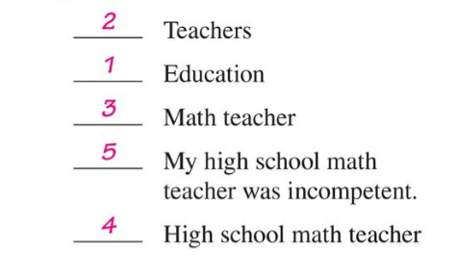

Slide 15
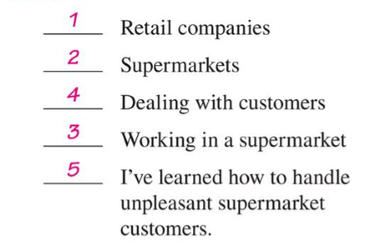
Notes:
Tell the difference between supermarket/metro/express.

Slide 16
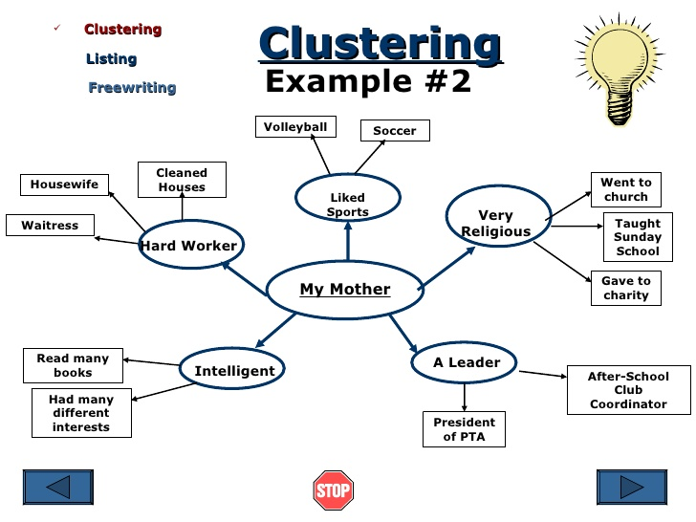
How to Limit?
Notes:
limit
narrow down
focus on two or three main points under this topic
how to choo these main points：
You know most about; you are most interested in; you are most passionate about.
Pay attention to the logic/connection between those points.

Slide 17
Check P.52 - 53

Slide 18
Common Errors in Writing a Thesis
ANNOUNCEMENTS rather than statements
Statements that are too broad
Statements that are too narrow
Statements that contain more than one idea

Slide 19
Announcements
Ex.: I want to talk about the crime wave in our country.
The sentence above merely tells the subject of the paper.
A thesis statement must advance a point about a limited subject.
Notes:
Goldilocks and the three bears
Announcement is sth puclic, something everyone knows. it is not your personal opinion and since everyone knows/believes, there is no meaning to prove it.

Slide 20
A Good Thesis
A good thesis is neither too broad nor too narrow:
too broad
Crime is a major concern of everyone in our country.
too narrow
My parents had only one child.
JUST RIGHT
A honeymoon is perhaps the worst way to begin a marriage.

Slide 21
Too Many Ideas
Ex.: My parents helped me grow in important ways, although in other respects I was limited.
In the statement above, the reader is asked to focus on two separate points, each of which more logically belongs in an essay of its own.

Slide 22
Step 2: Supporting with Specific Evidence
Write down a brief version of your thesis and then jot down the three points that will support it.
Notes:
Remind nonnative students to avoid using circular reasoning, which simply restates the main idea and does not provide supporting details. Although this pattern may be used in some cultures, it is not acceptable in academic writing.

Slide 23
The Importance of Specific Details
Develop your supporting points with specific details.
WHY?
Because
details excite the reader’s interest.
details serve to explain a writer’s point.
Notes:
Have students look at a previously written paragraph to see if they used specific details.

Slide 24
The Importance of Adequate Details
Provide enough specific details to fully support the point in a body paragraph.
Notes:
Students often use repetition and wordy generalizations when faced with a word-count or minimum-page requirement. Remind them that brainstorming can be done after a draft is written to generate more support.

Slide 25
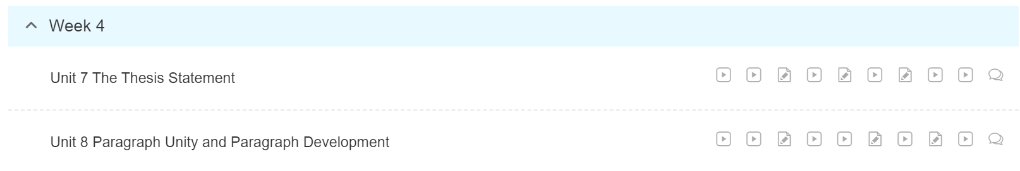
To Do List
完成教材Chapter 3 的学习。（Quiz next week）
进行慕课学习，完成Week 4，Unit 7 的讨论。（其他部分有时间的话可以去做，推荐倒数第一和第二个视频。）

Slide 26
Homework (DDL: 2020/3/15 Sunday 12:00noon)
Textbook:
必做：
P.63: Activity 8
P.66: Activity 10-13
选做：(extra bonus)
P. 68- P. 69 Activity 14-15
submission: QQ Group - Homework

Slide 27
CQUPT
SCHOOL OF FOREIGN LANGUAGES
Thank you！
www.cqupt.edu.cn

